Slide 1
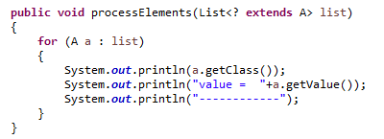
The extends Wildcard Boundary
List<? extends A> means a List of objects that are instances of the class A, or subclasses of A (e.g. B and C).
When you know that the instances in the collection are of instances of A or subclasses of A, it is safe to read the instances of the collection and cast them to A instances.
The processElements() method still cannot insert elements into the list, because you don't know if the list passed as parameter is typed to the class A, B or C.

